Slide 1

FinTrackr
A Smart Stock Portfolio Tracker
By UnderDog Analysts
Abhishek C Margoor
Abhinav Thakare
Aashi Chahal
Abhishek Khodke
Abhishek Thorat
Aditya Undalkar
FinTrackr

Slide 2

The Challenge for Retail Investors
Retail investors face significant obstacles in managing their portfolios effectively. Manual spreadsheet tracking is labour-intensive, error-prone, and lacks the sophistication needed for strategic decision-making. Calculating weighted averages when buying stocks at different prices is mathematically complex, and most investors lack secure, personalised tools to analyse their investments systematically.
FinTrack

Slide 3
Introducing FinTrackr
A full-stack web application built with Python and Flask, designed to simplify portfolio management for retail investors.
Secure Authentication
Portfolio Management
User registration and login with encrypted password storage
Complete CRUD operations for stock tracking and updates
Smart Averaging
Loss Management
Automatic weighted average calculation for repeated purchases
Strategic calculator for informed investment decisions
FinTrackr

Slide 4

Technology Stack
Backend & Database
Frontend & Security
Python with Flask framework
Bootstrap 5 for responsive design
Flask-SQLAlchemy ORM
SQLite database
Jinja2 templating engine
Flask-Bcrypt for security
Chart.js for visualisations
Flask-Login for session management

Slide 5
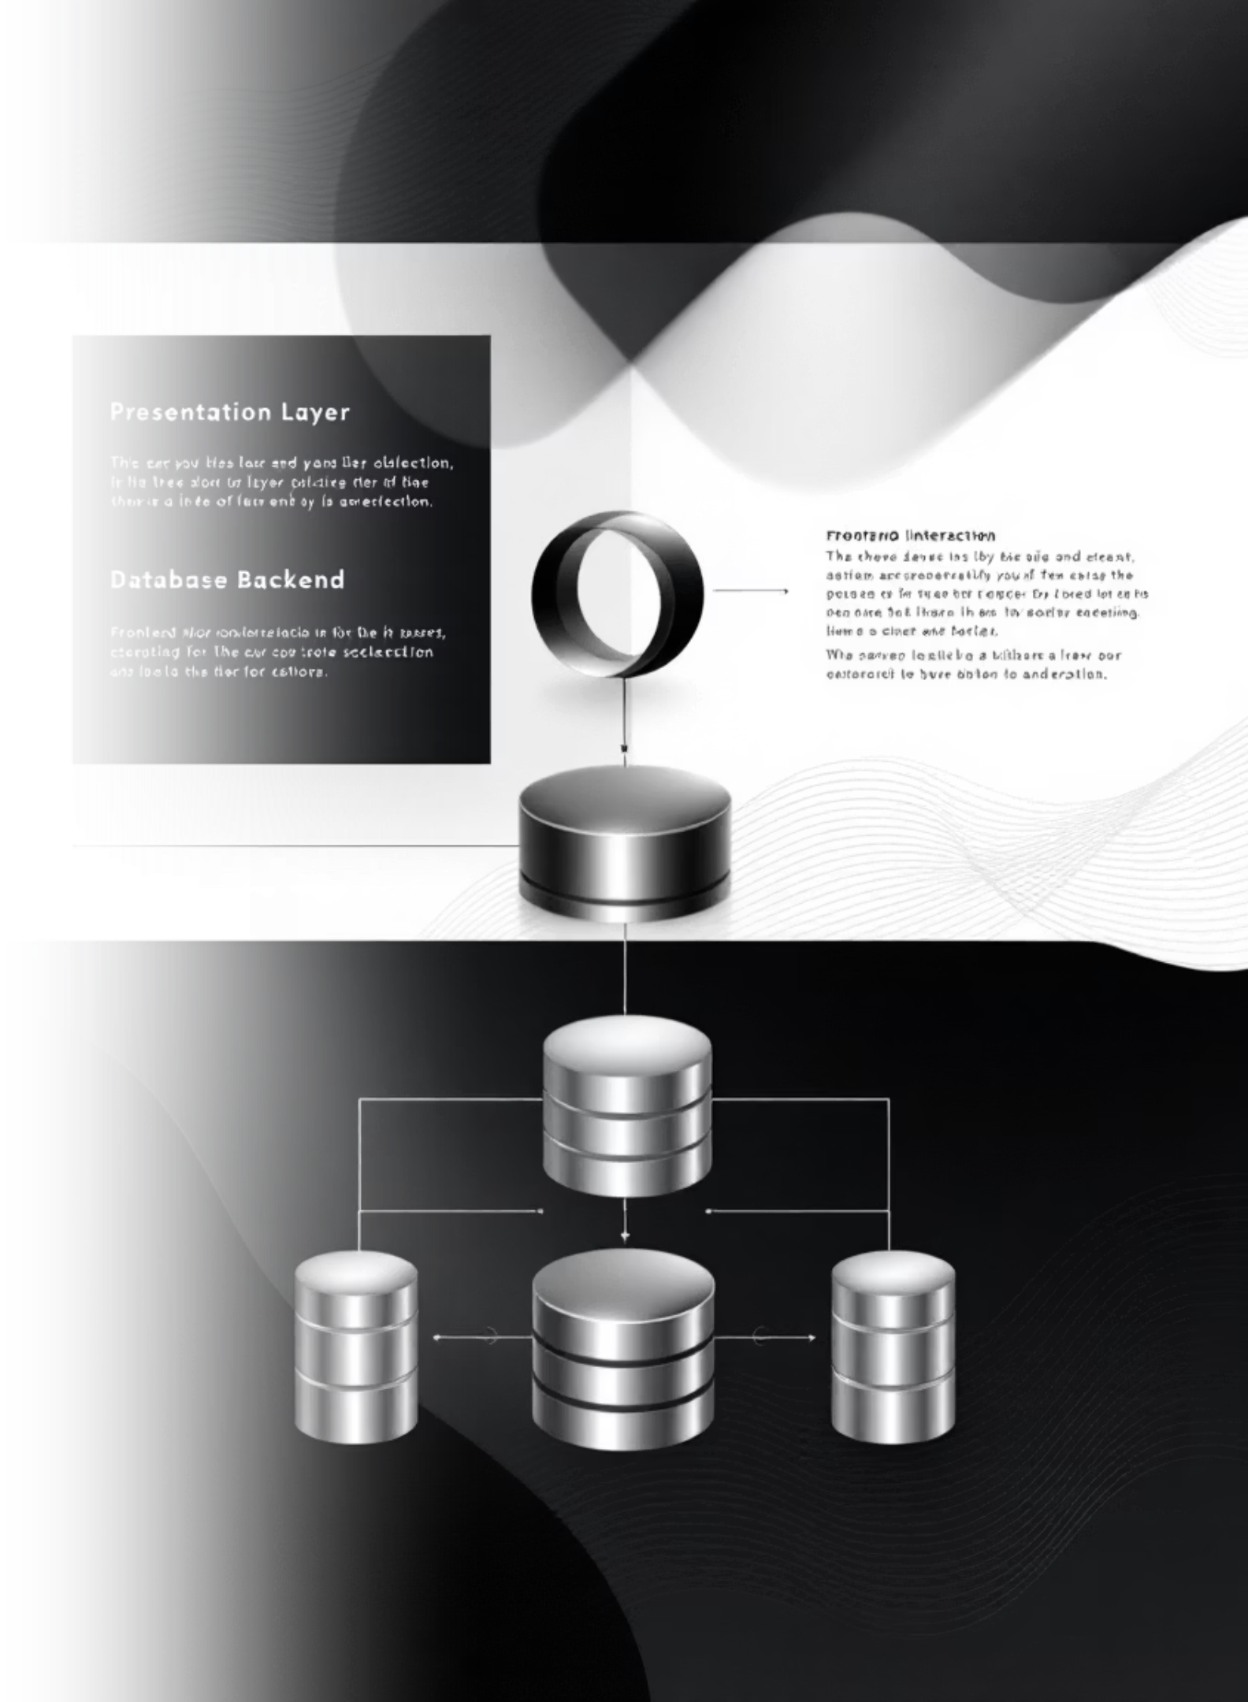
System Architecture: Three-Tier Design
Presentation Layer
HTML, CSS, and JavaScript interface where users interact with the application, built with Bootstrap 5 for responsive design and Chart.js for financial visualisations
Logic Layer
Flask backend handles all business logic, route management, portfolio calculations, and authentication. This layer processes user requests and manages the complex financial computations
Data Layer
SQLite database stores all user credentials and stock information, managed through SQLAlchemy ORM. Ensures data persistence and supports relational queries

Slide 6
Database Design: Entity Relationship Model
FinTrackr uses a relational database structure with two core entities connected by a one-to-many relationship.
User Table
Stock Table
id (Primary Key)
id (Primary Key)
username (Unique)
stock_name
password (Hashed)
quantity
email
buy_price
current_price
user_id (Foreign Key)
Relationship: One user can manage multiple stock entries. This design enables secure, segregated portfolio management for each investor.
FinTrackr

Slide 7


Key Feature: Smart Stock Averaging
When purchasing the same stock at different prices, FinTrackr automatically consolidates the entries into a single record with the weighted average buy price recalculated in real-time.
Formula: P_{\text{new\_avg}} = \frac{(Q_1 \times P_1) + (Q_2 \times P_2)}{Q_1 + Q_2}
Example: Buying 10 shares at ₹3500, then 10 more at ₹3400 automatically results in 20 shares recorded at ₹3450 average cost—eliminating manual calculations and potential errors.

Slide 8
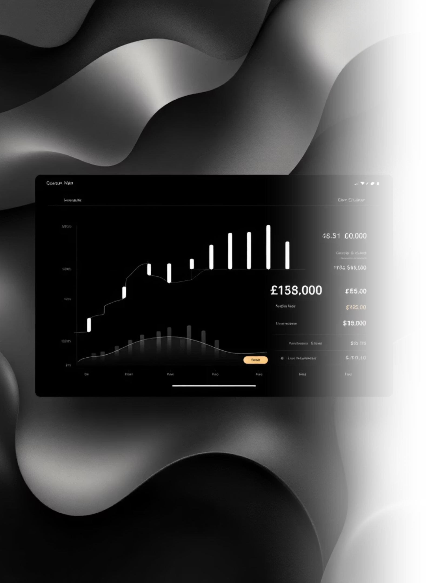
Key Feature: The "Manage Loss" Calculator
This sophisticated tool empowers investors to make data-driven decisions on losing positions by calculating exactly how many shares at a target price are needed to achieve their desired average cost basis.
Formula: Q_2 = \frac{Q_1 \times (P_1 - P_{\text{target}})}{P_{\text{target}} - P_2}
By entering a target average price they want to achieve, investors receive precise guidance on investment requirements, transforming uncertainty into strategic clarity.

Slide 9

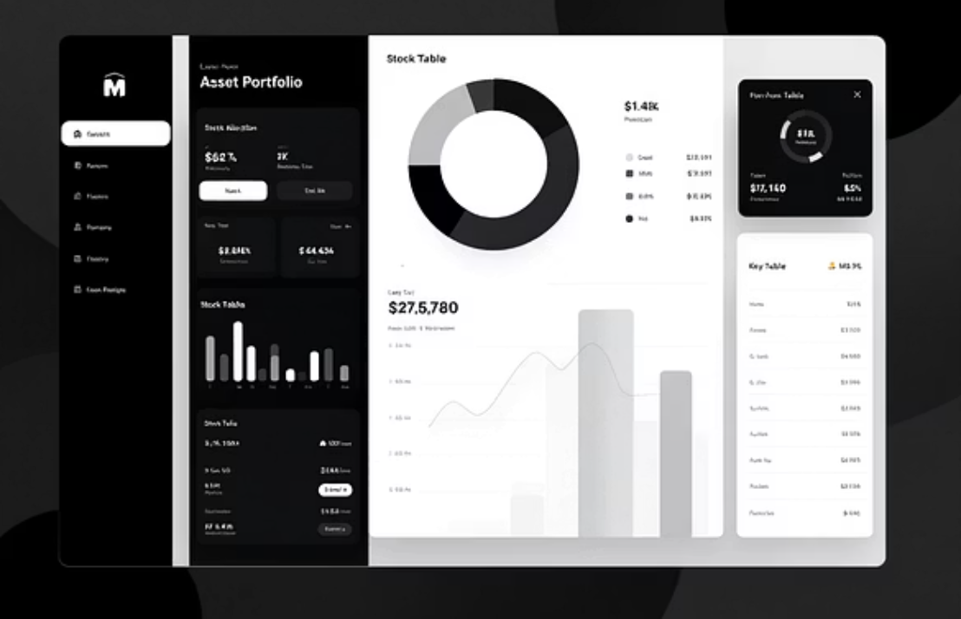
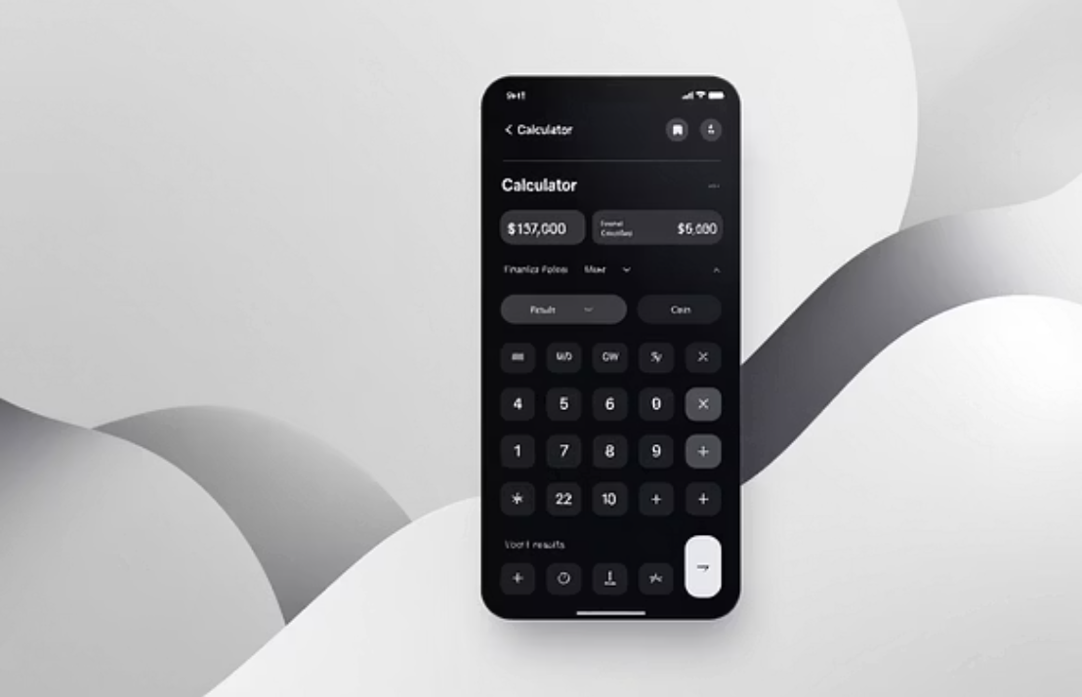
Application in Action: Visual Showcase
FinTrackr's user interface combines security, functionality, and elegant design across three key sections:
From secure authentication to comprehensive portfolio visualisation to advanced financial calculations, every component works in harmony to deliver a professional investment management experience.

Slide 10

Future Enhancements & Vision
Live Market Integration
Historical Performance Analytics
Connect to Yahoo Finance or Alpha Vantage API for real-time stock price updates, eliminating manual entry and ensuring data accuracy
Add interactive line graphs tracking portfolio performance over time, enabling trend analysis and investment pattern recognition
Data Export Functionality
Watchlist Feature
Enable CSV export for external analysis, tax reporting, and record-keeping purposes
Create a monitoring system for stocks under consideration before purchase, with price alerts and performance tracking
Vision: FinTrackr demonstrates how thoughtful full-stack development solves real-world investor problems through secure architecture, intelligent automation, and user-centred design.

